Slide 1
Understanding Section 3
Sherry Zou, Housing Programs Manager
City of Quincy, Massachusetts
June 12, 2024

Slide 2
Agenda
Overview
The Rule
Definitions
Reporting Requirements
Tools & Resources

Slide 3
The Authority
1968 Section 3 is codified in the Housing and Urban Development Act
1995 FHEO published the current regulations in 24 CFR Part 135
2015 FHEO published new proposed regulations in 24 CFR Part 135, which never became final
2019 FPM published proposed regulations in 24 CFR Part 75
2021
Compliance on the new regulations in 24 CFR Part 75 begins
Notes:
Section 3 originated from the Housing and Urban Development Act of 1968. HUD proposed a new rule in 2015 which was never finalized and then it proposed the current or ‘new’ rule in 2019, finalizing it on November 30th with a delayed effective date (transition) of July 1, 2021. Section 3 is not a program. It’s a provision of HUD’s law - under 24 C.F.R. Part 75 Subparts A, C, & D.
it is a law that we think of in terms of a program due to the way we stress compliance. In the way that we provide training, set goals, standards, and benchmarks, Section 3 may often look like a program, however it is indeed a law. The reason behind this “program management” approach is to work past the “checkbox” requirement, and instead see the potential that this law has in improving the lives of Public Housing residents, low-income workers, and local businesses. Today we will go over some information on the rule changes that have been put into effect as of November 30, 2020.

Slide 4
The Purpose
Organizations
Residents
Self-Sufficiency
To ensure that the employment and other economic opportunities generated by Federal financial assistance for housing and community development programs shall, to the greatest extent feasible, be directed toward low- and very low-income persons, particularly those who are recipients of government assistance for housing.
Section 3 of the Housing and Urban Development Act of 1968
Notes:
Section 3 is a provision of the Housing and Urban Development Act of 1968. The purpose of Section 3 is to ensure that employment and other economic opportunities generated by certain HUD assistance goes, to the greatest extent feasible, to low- and very low-income persons, particularly those who are recipients of government assistance for housing and to business concerns which provide economic opportunities to low- and very low-income person.
The idea behind the passage of Section 3 was to keep HUD dollars local. When HUD funds are spent on community projects or improvements, the work generated by the investment should be maximized by having any employment opportunities be offered to persons living in subsidized housing. The overarching theme and goal with Section 3 is that when HUD funds are being used to assist a community’s infrastructure, it will also be used to boost the economic impact within that community by hiring businesses and workers within the low-income brackets.
Section 3 is not a program; it is a law that we think of in terms of a program due to the way we stress compliance. In the way that we provide training, set goals, standards, and benchmarks, Section 3 may often look like a program, however it is indeed a law. The reason behind this “program management” approach is to work past the “checkbox” requirement, and instead see the potential that this law has in improving the lives of Public Housing residents, low-income workers, and local businesses. Today we will go over some information on the “new” rule that have been put into effect as of November 30, 2020.

Slide 5
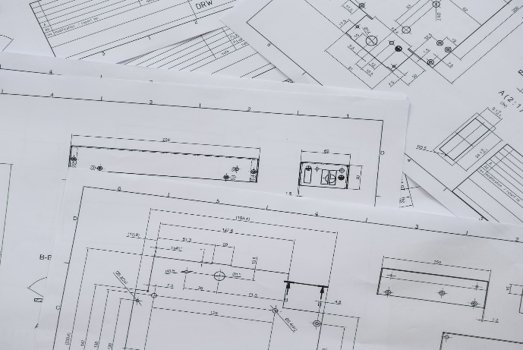
The Purpose
administration, management, clerical support, construction: accounting, architecture, appliance repair, bookkeeping, bricklaying, carpentry, carpet installation, catering, cement/ masonry, computer/ information, demolition, drywall, electrical, elevator construction, engineering, fencing,
florists,
Heating/HVAC,
iron works, janitorial, landscaping, lawncare, legal, machine operation, maintenance, manufacturing, marketing, painting,
payroll, photography, plastering, plumbing, printing, purchasing, research, surveying,
tile
setting, transportation, welding,
word
processing
JOBS
TRAINING
CONTRACTS
Notes:
Before I do that, I want to discuss some basics of Section 3. As I said, the intent is to provide economic opportunities to a person who qualifies as a Section 3 worker (which I’ll go over the definition later of Section 3 worker). You can see on this page the variety of job titles along the bottom. These are examples of how Section 3 can be used to employ worker, and there is a wide range of support needed in development and construction projects, many of which can be filled by qualified Section 3 workers. Then the Section 3 workers can use this project as an opportunity to develop their skills and experience and support their long-term career development.

Slide 6
Applicability
Local Government
Builder
Nonprofit
Private Agency
Developer
Mortgagor
Property Manager
Public Housing Agency
Cooperative
Resident Council
Community Housing Development Organization
HOPWA
§ 202/811
HOME
VHRMP
CDBG
ESG
HTF
NSP
CoC
Lead
RAD
EDI
Notes:
These are some examples of programs and agencies that may be subject to Section 3 requirements. For Public Housing, most expenditures are subject to the rule. Today, we’re going to just focus on the Housing and Community Development assistance not the Public Housing side of Section 3 (because they have a slightly different definitions and requirements).
Some examples of the programs covered by Section 3 are like HOME, CDBG, ESG, Coc, Lead, etc.

Slide 7
Definition: Section 3 Project
Housing rehabilitation, housing construction, and other public construction project assisted under HUD programs that provide Housing and Community Development financial assistance when the total amount of assistance to the project exceeds a threshold of $200,000.
**The threshold is $100,000 where the assistance is from the Lead Hazard Control and Healthy Homes program.
A project for this purpose is the site or sites together with any building(s) and improvements on the site(s) that are under common ownership, management, and financing.
Notes:
What does Section 3 project mean? Section 3 applies to housing rehabilitation, housing construction, and other public construction projects assisted under HUD programs that provide housing and community development financial assistance where the amount of assistance to the project exceeds a threshold of $200,000. Note that the threshold is $100,000 where the assistance is from HUD’s Lead Hazard Control and Healthy Homes programs.
Some key points here to keep in mind is the $200,000 threshold is for total HUD assistance. We are talking about this on a project level. The definition of a project is the site or sites together with any building(s) and improvements on the site(s) that are under common ownership, management, and financing. For example, if you have a project that has HOME or CDBG over $200,000 going into that project, then the Section 3 rules will apply.

Slide 8
Definition: Section 3 Worker
A Section 3 worker is, or when hired in the past 5 years was:
A low- or very low-income individual
OR
A Youthbuild participant
OR
Employed by a Section 3 business concern
Notes:
A Section 3 worker is, or when hired within the past five years was:
A low- or very low-income individual (the worker’s income for the previous or annualized calendar year is below the income limit established by HUD; (80%) AMI)
A Youthbuild participant or
Employed by a Section 3 business concern

Slide 9
Definition: Section 3 Business
A Section 3 business is, documented within the last six-month period:
51% or more owned by low- or very low-income persons
OR
75% or more labor hours are performed by Section 3 workers
OR
51% or more owned by current residents of public housing or Section 8-assisted housing
Notes:
Section 3 business concerns are businesses that meet at least one of the following criteria, documented within the last six-month period:
At least 51 percent owned and controlled by low- or very low-income persons;
Over 75 percent of the labor hours performed for the business over the prior three-month period are performed by Section 3 workers; or
A business at least 51 percent owned and controlled by current public housing residents or residents who currently live in Section 8-assisted housing.

Slide 10
Definition: Targeted Section 3 Worker
A targeted Section 3 worker is a Section 3 worker who is:
Employed by Section 3 business concern; or
Who currently fits or when hired fit one of the following definitions, as documented in the previous five years:
Resident of public housing or Section 8 assisted housing; or
A resident of another project managed by the PHA; or
A YouthBuild participant
Workers
Public Housing Recipients
Section 3 workers
Targeted Section 3 workers
Employed by Section 3 business concern; or
Who currently fits or when hired fit one of the following definitions, as documented in the previous five years:
Living within the service area or the neighborhood of the project; or
A YouthBuild participant
Housing & Community Development Recipients
Notes:
The definition of Targeted Section 3 worker is a Section 3 worker who is:
Employed by Section 3 business concern; or
Who currently fits or when hired fit one of the following definitions, as documented in the previous five years:
Living within the service area or the neighborhood of the project; or
A YouthBuild participant
EMPHASIZE: All Targeted Section 3 Workers are Section 3 Workers, but not all Section 3 Workers are Targeted Section 3 Workers.

Slide 11
Definition: Section 3 Business
A Section 3 business is, documented within the last six-month period:
51% or more owned by low- or very low-income persons
OR
75% or more labor hours are performed by Section 3 workers
OR
51% or more owned by current residents of public housing or Section 8-assisted housing
Notes:
Section 3 business concerns are businesses that meet at least one of the following criteria, documented within the last six-month period:
At least 51 percent owned and controlled by low- or very low-income persons;
Over 75 percent of the labor hours performed for the business over the prior three-month period are performed by Section 3 workers; or
A business at least 51 percent owned and controlled by current public housing residents or residents who currently live in Section 8-assisted housing.

Slide 12
Section 3 HCD Requirements
Employment and Training: To the greatest extent feasible ensure employment and training opportunities arising from Section 3 projects are provided to Section 3 workers within the metropolitan area or nonmetropolitan county in which the project is located.
When feasible priority should be given to:
Section 3 workers residing within the service area or the neighborhood of the project; and
YouthBuild participants.
Contracting: Ensure contracts for Section 3 projects are provided to business concerns that provide economic opportunities to Section 3 workers residing in the metropolitan area, or nonmetropolitan county, in which the project is located.
When feasible priority should be given to:
Section 3 business concerns that provide economic opportunities to Section 3 workers residing within the service area or the neighborhood of the project; and
YouthBuild programs.
Notes:
Once you identify that Section 3 is applicable the rule requires the funding recipient to undertake certain actions relating to employment and training of its own workforce and for any contracts entered into (other than material only contracts).
To the greatest extent feasible, the recipients must ensure employment and training opportunities arising from Section 3 projects are provided to Section 3 workers.
When feasible priority should be given to:
Section 3 workers residing within the service area or the neighborhood of the project; and
YouthBuild participants.
Similarly, for Contracting, recipients must ensure contracts for Section 3 projects are provided to business concerns that provide economic opportunities to Section 3 workers.
When feasible priority should be given to:
Section 3 business concerns that provide economic opportunities to Section 3 workers residing within the service area or the neighborhood of the project; and
YouthBuild programs.
(It is important to note that Section 3 is a preference, not an entitlement. Section 3 workers and business concerns must still demonstrate they have the ability or capacity to perform the specific job or successfully complete the contract/employment they are seeking.)

Slide 13
Section 3 HCD Requirements -Contract Provisions
Recipients must:
include language applying Section 3 requirements in any subrecipient agreement or contract for a Section 3 project.
Require subrecipients, contractors, and subcontractors to meet the requirements of 24 C.F.R. § 75.19, regardless of whether Section 3 language is included in the recipient or subrecipient or other agreements.
Notes:
When contracting with Section 3 financing, the rule requires the funding source to include requirements within any contract or subrecipient agreement– other than material only contracts. NOTE: Section 3 applies EVEN IF these provisions are not included in the contract – no omission exception

Slide 14
Section 3 Safe Harbor
Recipients will be considered to have complied with Section 3, absent any contrary evidence, if they:
Certify that they have followed the prioritization effort in 24 C.F.R. § 75.9 (PHA) or § 75.19 (HCD); and
Meet or exceed the applicable Section 3 Benchmarks (published in Fed. Register for comment at least every three years)
Benchmarks for Section 3 projects
Section 3 labor hours
Total labor hours
Targeted Section 3 labor hours
Total labor hours
=25% AND
= 5%
A labor hour is:
Workers
Section 3 workers
Targeted Section 3 workers
Hours worked by all workers employed on a Section 3 project
A targeted Section 3 worker is Section 3 worker who is:
Employed by a Section 3 business concern
OR
A Section 3 worker living in the project’s service area or neighborhood of the project
OR
A current YouthBuild participant
Notes:
Now I’ll discuss the safe harbor provision. To meet the safe harbor, the funding recipients must
Self-certify that they followed the prioritization efforts and (remember: when there’s a job opportunity - priority should be given to Section 3 workers residing within the service area, YouthBuild participant, etc; contracting – priority should be given to Section 3 business)
Met or exceeded the Section 3 benchmarks (published in Federal Register for comment at least every three years)
And here’s the benchmarks for Section 3 projects:
This new rule requires the recipients to track and report on labor hours instead of new hires (which we used to do under the old rule). Labor hours mean the number of hours worked by all workers employed on a Section 3 project.
The benchmark for Section 3 workers is set at 25% or more of the total number of labor hours, and the benchmark for Targeted Section 3 workers is set at 5% or more of the total number of labor hours.
That’s why it’s important to identify who the Section 3 and Targeted Section 3 workers are for your Section 3 project, and ensure that the hours worked by Section 3 worker are 25% or more and the hours worked by Targeted Section 3 workers are 5% or more of the total labor hours to meet the safe harbor. (5% is contained in the 25%)
NOTE: A BENEFIT TO CONTRACTING SECTION 3 BUSINESSES
If you contract with a non-section 3 business must count labor hours for each employee to see who qualifies as a section 3 worker….BUT
If you contract with a Section 3 certified business concern you can count ALL the labor hours of employees of that business because one way to qualify as a Section 3 worker is to be employed by a Section 3 business.

Slide 15
Compliance
First notice of postings
Measurable targets
Training for job seekers
Notes:
The rule considers that complying with the Section 3 requirements can be challenging. Given the rule states “the greatest extent feasible” it is important that efforts to meet the rule requirements be well documented. We will go over later some examples or suggestions of what grantees can do to show their efforts to meet the rule requirements/benchmarks.

Slide 16
Examples of Qualitative Reporting
Outreach efforts to generate job applicants who are Targeted Section 3 workers
Training/apprenticeship opportunities
Technical assistance provided to help Section 3 workers compete for jobs (resume assistance, etc.)
Provide/connect Section 3 workers with assistance in seeking employment
Holding job fairs
Provided/referred Section 3 workers to services supporting work readiness and retention
Provided assistance to apply for/or attend education/vocational training
Provide financial literacy training
Engage in outreach to identify and secure bids from Section 3 business concerns
Provide technical assistance to Section 3 business concerns to help them understand Section 3 requirements
Provide bonding assistance, guaranties, or other efforts to support viable bids from Section 3 business concerns
Promote use of Section 3 business registry and HUD Opportunity Portal
Outreach, engagement, or referrals with the state one-stop system
Notes:
These are some of the examples of what to consider when reporting qualitatively.

Slide 17
Record Keeping Requirements
Recipients must maintain documentation, or ensure that a subrecipient, contractor, or subcontractor maintains documentation, to ensure workers meet the definition of a Section 3 worker or Section 3 targeted worker:
Section 3 worker record requirements
Worker’s self-certification that their income is below the income limit from the prior calendar year
Worker’s self-certification of participation in a means-tested program such as public housing or Section 8
Certification from a PHA or Section 8 program manager that the worker is a participant in such a program
Employer’s certification that the worker’s income from that employer is below the income limit
Employer’s certification that the worker is employed by a Section 3 business concern
Targeted Section 3 worker record requirements
Worker’s self-certification of participation in a means-tested program such as public housing or Section 8
Certification from a PHA or Section 8 program manager that the worker is a participant in such a program
Employer’s certification that the worker is employed by a Section 3 business concern
Worker’s certification that the worker is a YouthBuild participant
Notes:
Recipients must maintain documentation, or ensure that a subrecipient, contractor, or subcontractor maintains documentation, to ensure workers meet the definition of a Section 3 worker or Section 3 targeted worker:
This is not that heavy of a lift-most just requires certification from the worker, the employer, or the entity providing the means-based housing. Again, once established may report on that Section 3 worker for five years – and can reestablish Section 3 eligibility at any time.

Slide 18
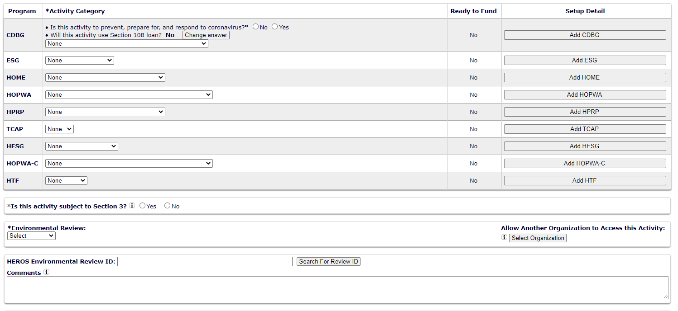
IDIS –Activity Setup Screen
Slide 18

Slide 19
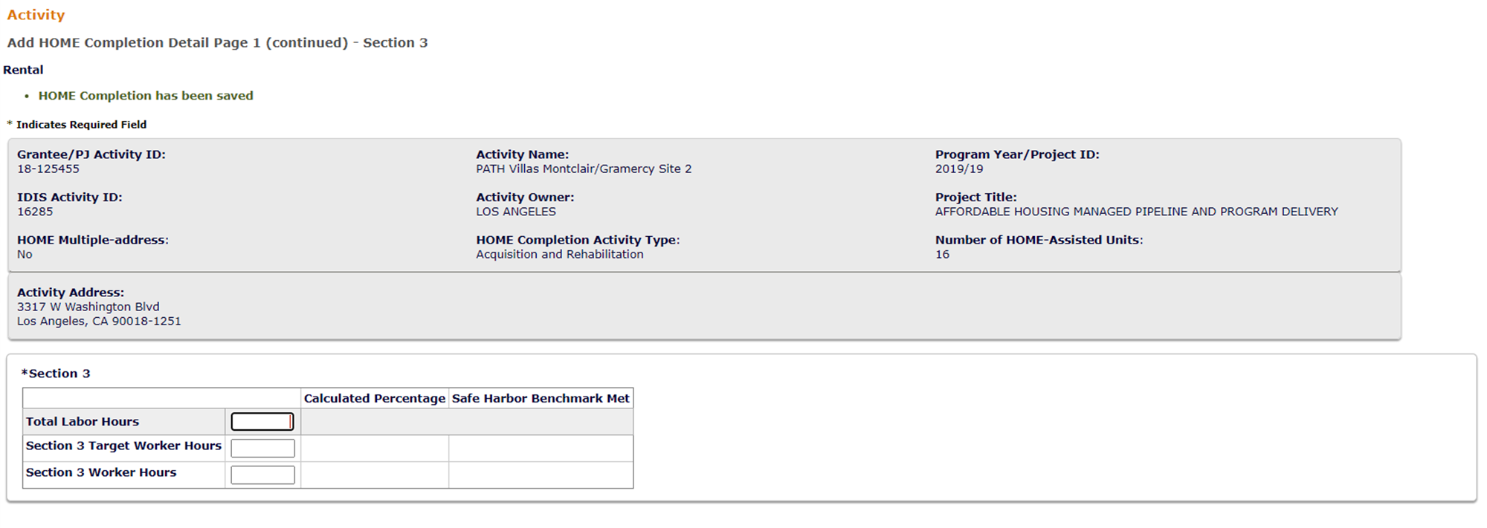
IDIS –Activity Setup Screen
Slide 19

Slide 20
IDIS –Activity Completion Screen (HOME)
Slide 20

Slide 21
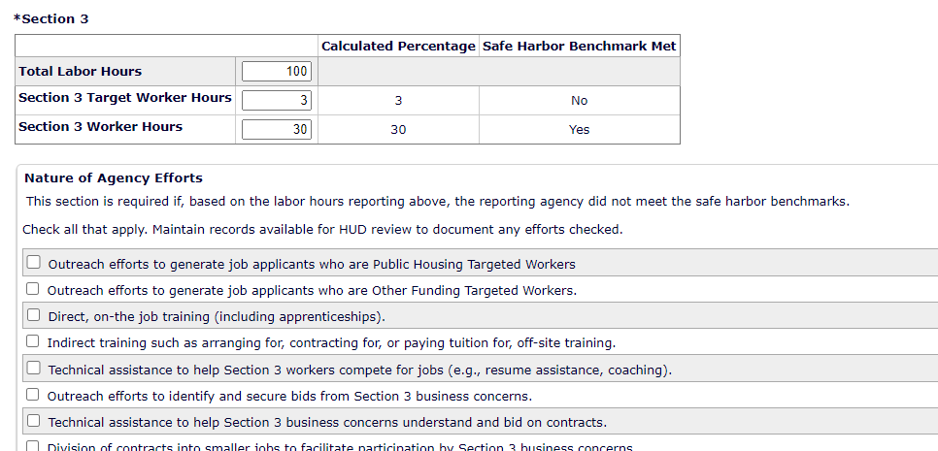
IDIS –Activity Completion Screen cont’d
Slide 21

Slide 22
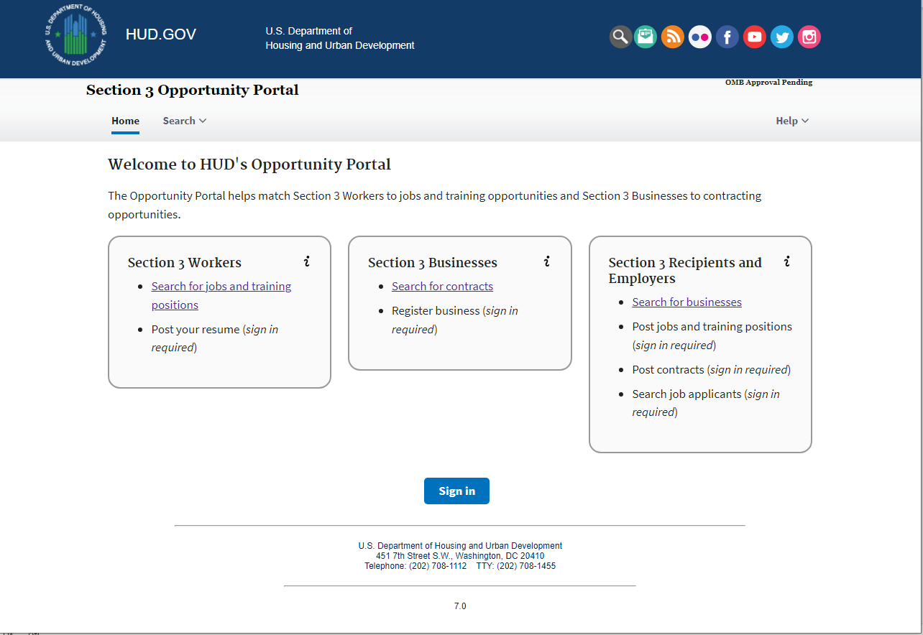
Section 3 – Opportunity Portal
Slide 22
Notes:
This tool is intended to help HUD grantees and Section 3 businesses meet their Section 3 benchmarks. The portal is to be used by Section3 workers, employers or Section 3 recipients.
As you can see on the screen, there are few things you can do with this portal:
Section 3 workers – any individuals who qualify as Section 3 worker – they can come here to search for jobs. And if they have an account or create an account, they can sign in and post their profile/employment history for companies to search.
Section 3 businesses – they can come here to search for contracting opportunities (by clicking search for contract), AND they can also register their business as Section 3 business (if they have their sign-in account). Once they self-certify themselves as a Section 3 business and register their business, they’ll be added to the Section 3 business registry. (Potential workers, General Contractors, and Grant Recipients may search for them and contact them directly for bid proposals)
In order to access the Business Registry, you click “Search for Businesses” So let’s say you want to hire or search for Section 3 business, then you can do so by clicking there and go through the list of Section 3 businesses. In addition, if the recipients or employers want to post jobs and contracts, or search for job applicants/potential Section 3 workers, they can do so by signing into their account.

Slide 23
Resources
Section 3 Final Rule (September 29, 2020)
Section 3 Benchmarks (September 29, 2020)
Frequently Asked Questions for Section 3 (March 25, 2021)
The New Section 3 Rule (24 C.F.R. Part 75) and RAD (March 16, 2021)
IDIS FAQs (October 18, 2021)
Section 3 Homepage
Section 3 Opportunity Portal
HUD Exchange – Section 3
Section3@hud.gov – general Section 3 questions
Sec3Biz@hud.gov – Section 3 Business Registry questions
Notes:
Here is a list of resources that are available currently as well as a list of contacts if you have questions. The slide will be sent out after the conference.

Slide 24
Thank You! Contact: Sherry Zou szou@quincyma.gov

